Slide 1
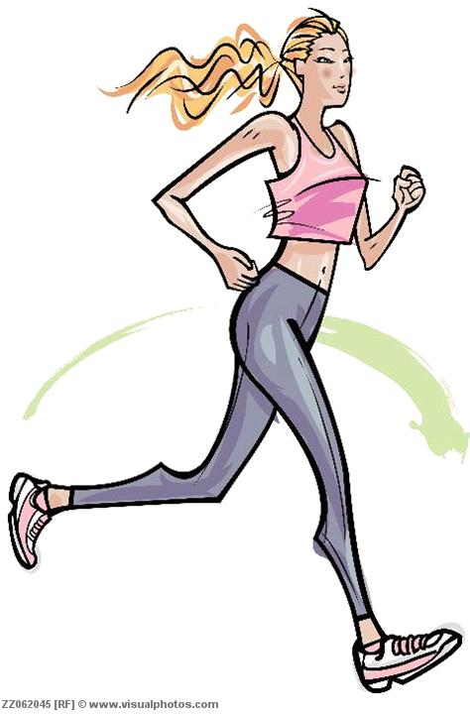
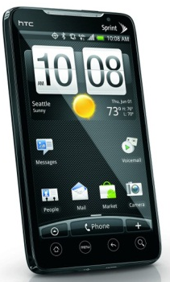
Activity Recognition using a Smartphone App
Project Guide: Prof Sanjivani Deokar
Group members:
Shivangi Saxena
Zeba Raheman

Slide 2
Introduction:
Business Insider's subscription research service, has recently calculated that One In Every 5 People In The World Own A Smartphone.
The statistics given below proves the following fact.

Slide 3
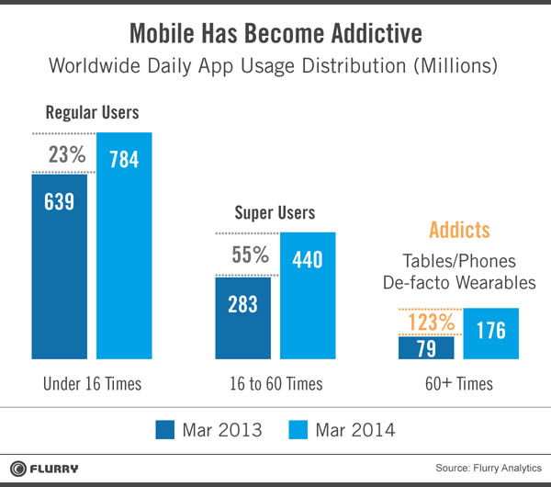
Daily mobile usage :

Slide 4
Activity Recognition :using accelerometer sensor
Using accelerometer sensor recognise the activities i.e At rest, walking and running and also help us to calculate the amount of calories burnt.
The main concept used here is Actigraphy .
Actigraphy is a non-invasive method of monitoring human rest/activity cycles. A small actigraph unit, also called an actimetry sensor, is worn by a patient to measure gross motor activity.

Slide 5
Algorithm used: ID3 algorithm
Calculate the entropy of every attribute using the training data set S.
Split the set S into subsets using the attribute for which entropy is minimum (or, equivalently, information gain is maximum).
Make a decision tree node containing that attribute.
Recurse on subsets using remaining attributes.

Slide 6
Future scope

Slide 7
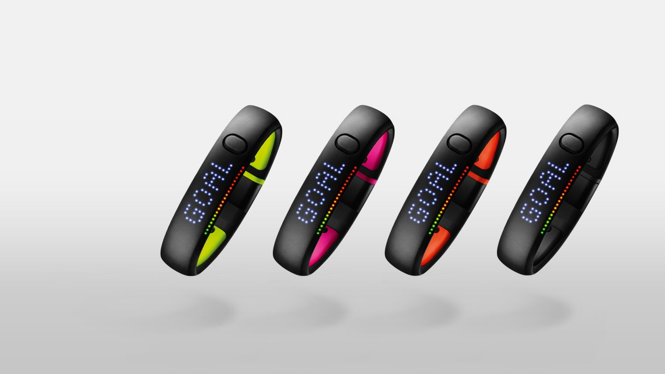
NIKE+ FUELBAND

Slide 8
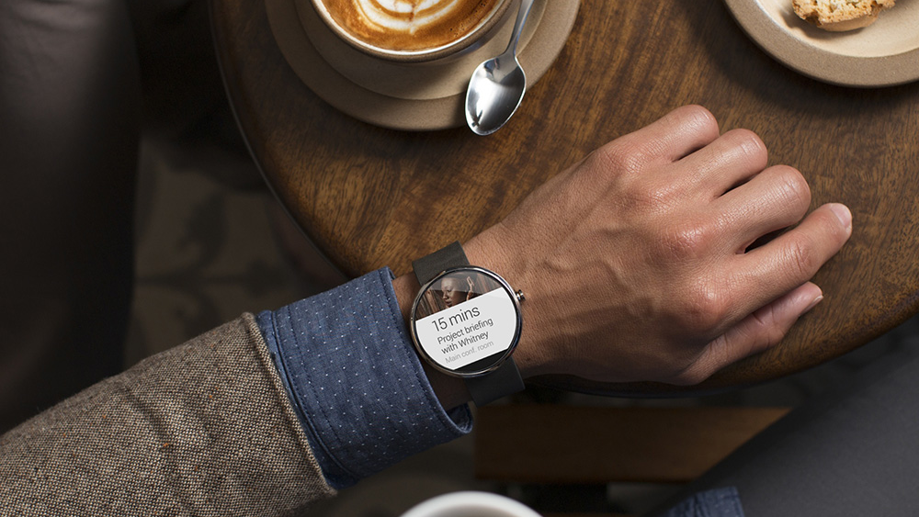
ANDROID WEAR

